Slide 1
Frothy Head Brewing Data Investigation

Slide 2
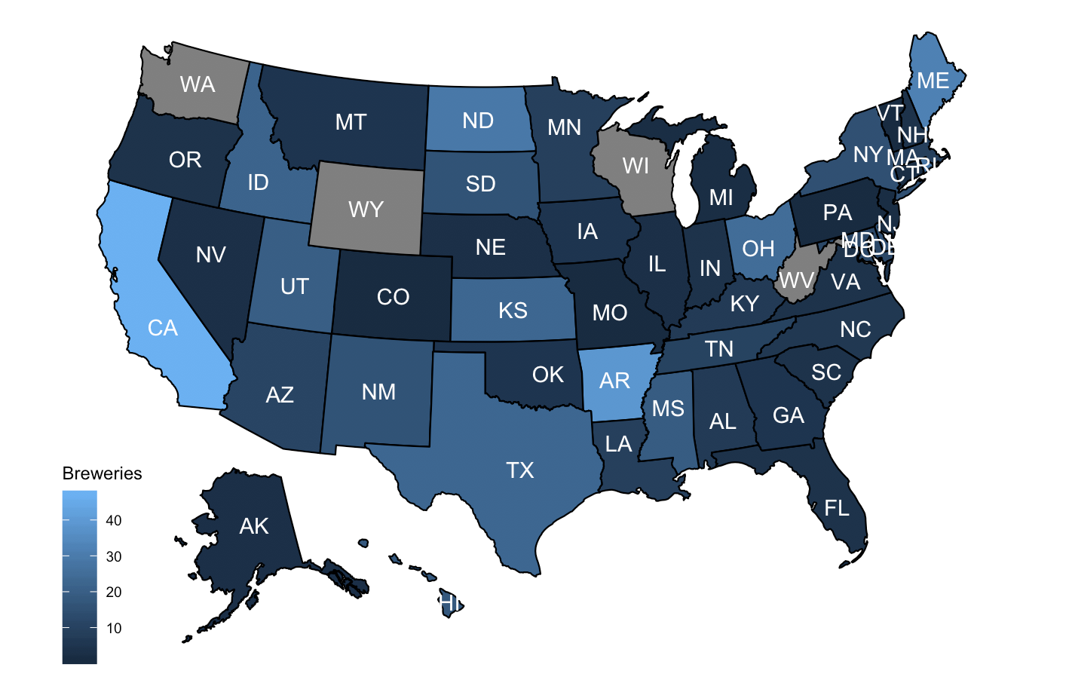
States Brewery Map
Finish figuring out how to change the colors to dark = many

Slide 3
Tables and Data
The provided data sets along with the cleaned and merged data can be found in the accompanying files along with the tables for the following:
The number of breweries per state
Missing values per variable
Statistical summary of alcohol content
Most alcoholic Beer
Most bitter beer

Slide 4
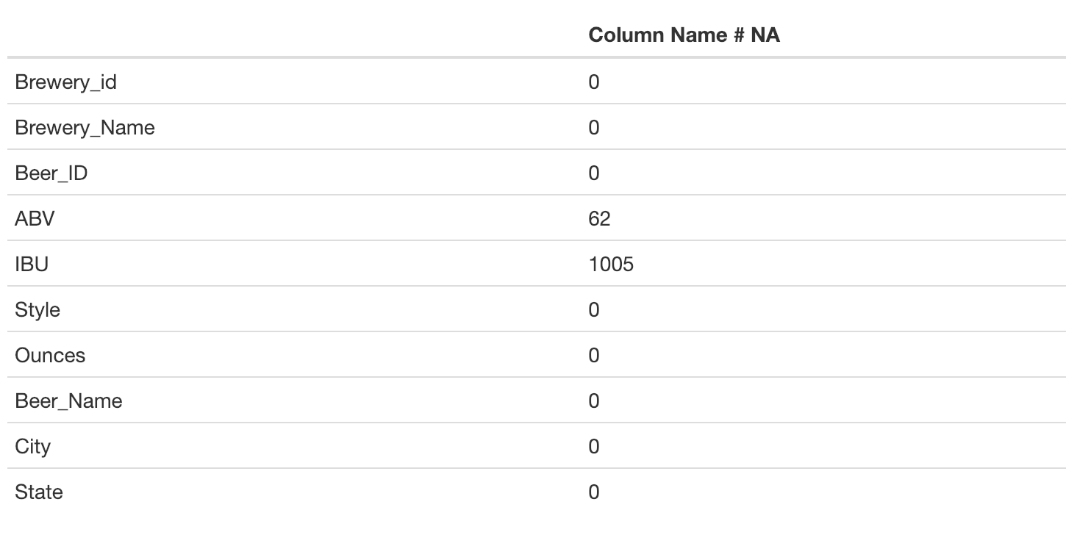
Missing Values
Change this to a bar chart

Slide 5
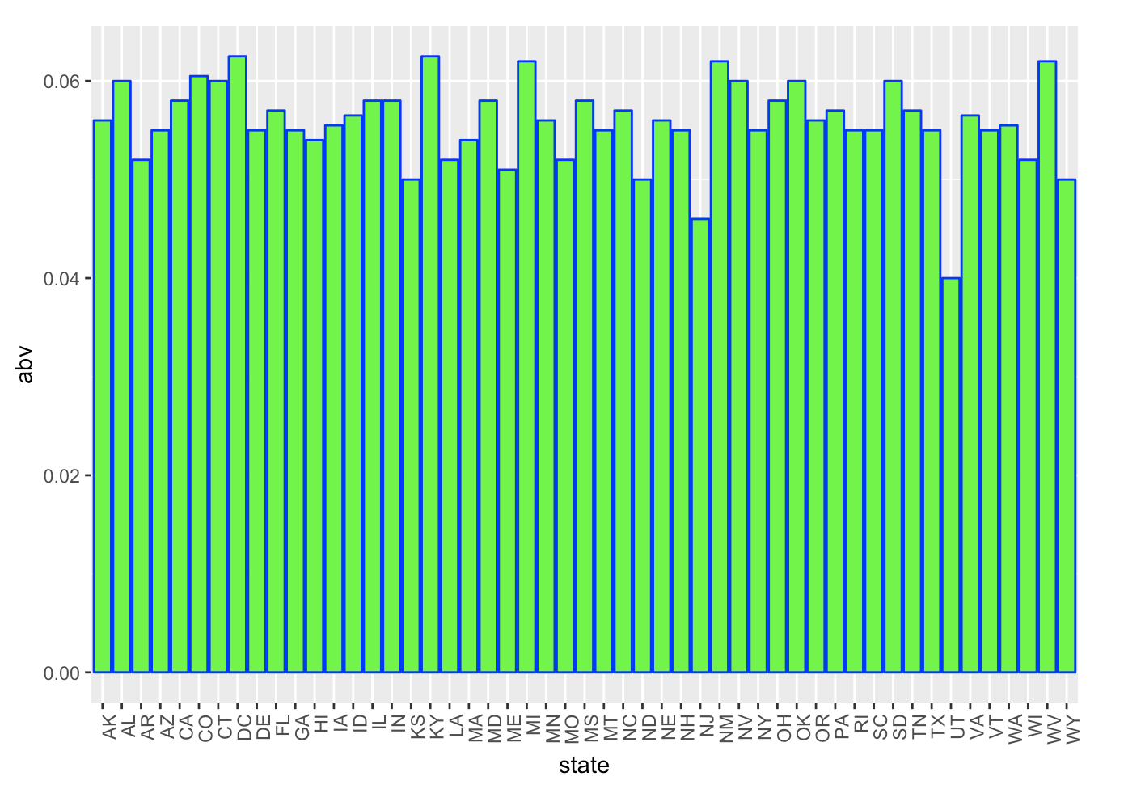
Median Alcohol Content by State
Fix colors
add title in rmd/html

Slide 6
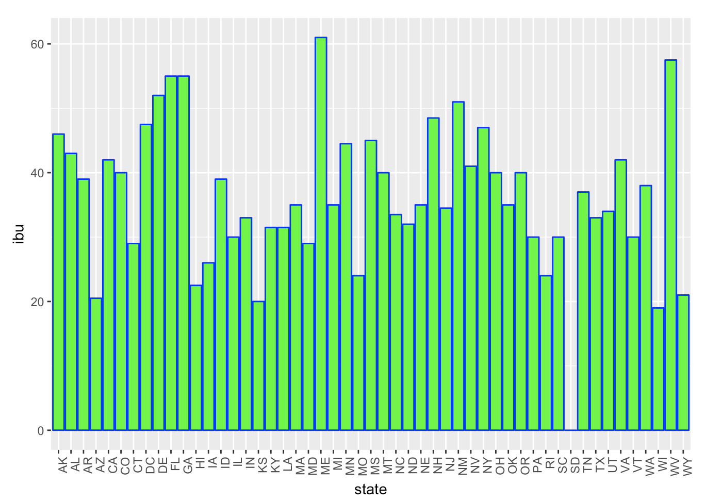
Median Bitterness IBU by State
Fix colors add title in rmd/html

Slide 7
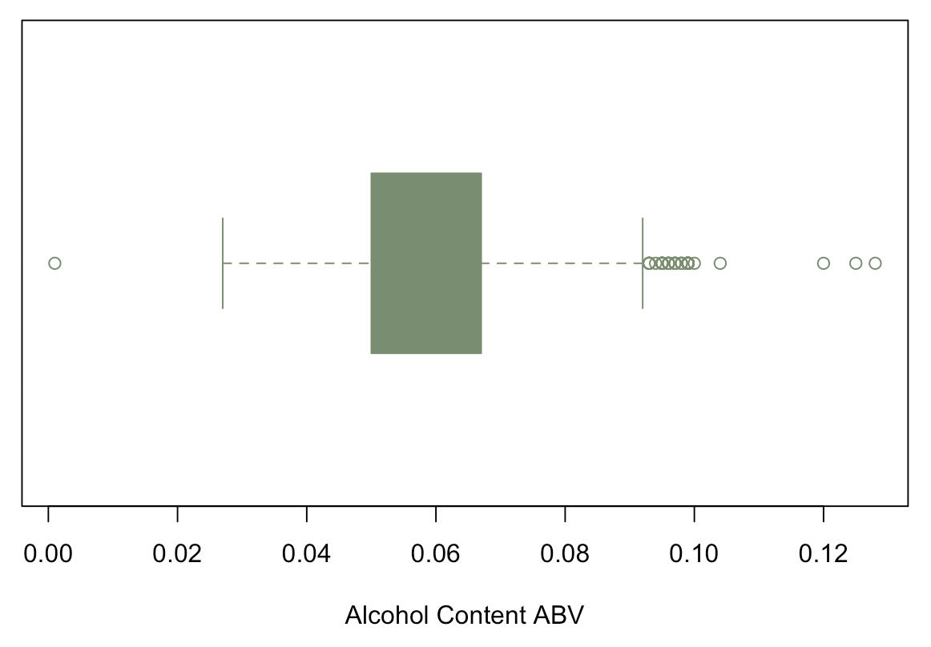
Summary of Alcohol Content ABV and The Most Alcoholic Beer
The most alcoholic beer is the Lee Hill Series Vol. 5 - Belgian Style Quadrupel Ale produced by Upslope Brewing Company in Boulder Colorado with an alcohol content of 0.128.

Slide 8
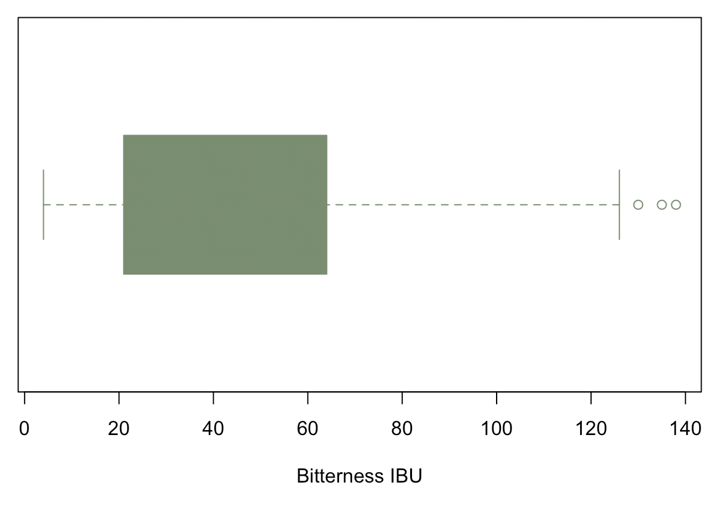
The Most Bitter Beer IBU
The most bitter beer is Bitter Bitch Imperial IPA produced by Astoria Brewing Company in Astoria Oregon with 1.38 international bitterness units.

Slide 9
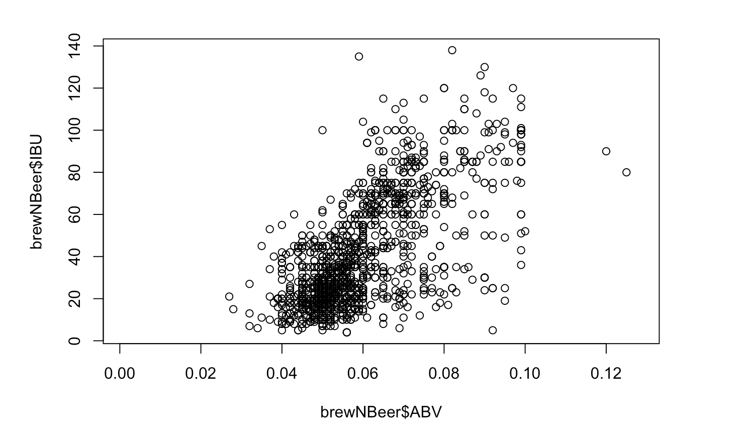
Alcohol Content ABV vs Bitterness IBU
Make more colorful add title to chart in rmd

Slide 10
Take Away
Our Conclusions Here

